Slide 1



KITCHEN TABLE
REV. 5/29/21

Slide 2
To help families earn more income and become properly protected,
debt free & financially independent.
Our Mission Statement:

Slide 3
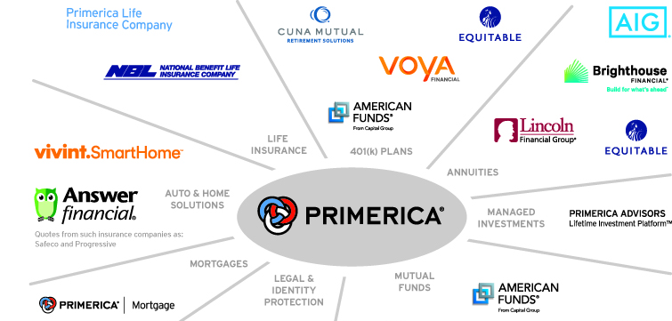

Slide 4



Bypass the Middleman – Become an Owner, Not a Loaner
Traditional Financial Institutions
Your Money
Global Economy
Banks, Credit Unions, Insurance Companies = Historically Low Rates of Return

Slide 5
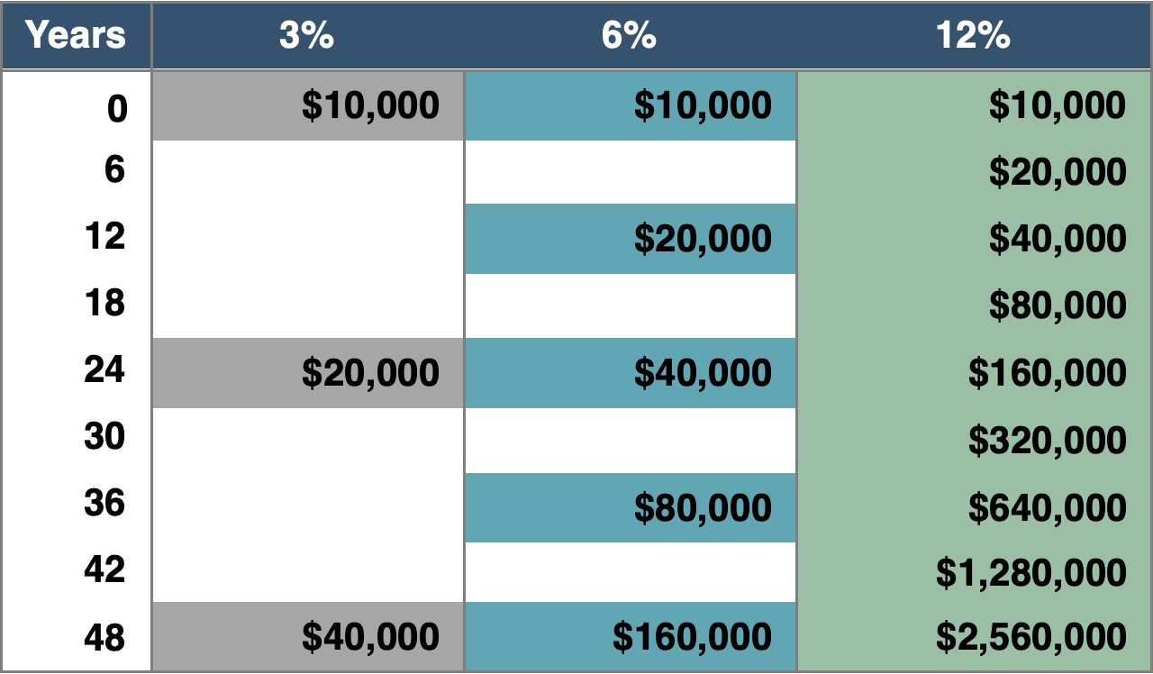
The Rule of 72
Divide your interest rate into 72 to find the approximate number of years it takes for money to double.
How do you win a game if you don’t know the rules?
Who would benefit from learning this rule?
Shouldn’t we have learned this rule in school?
Without introducing us to family and friends, how would they learn “The Rule of 72?”

Slide 6
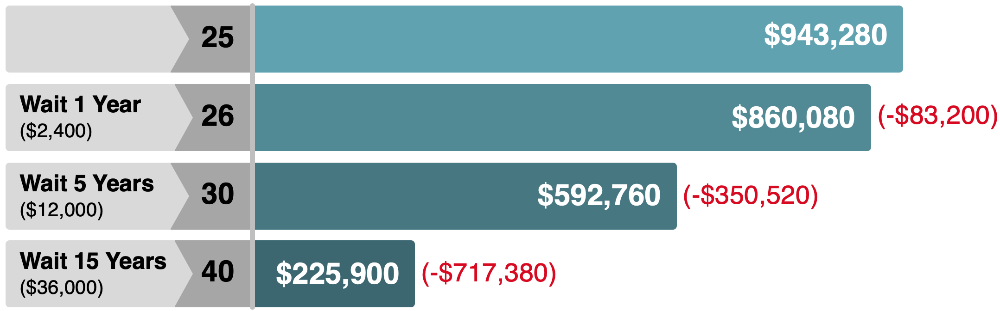
Pay Yourself First
When you don’t, there’s a high cost of waiting.
$200 Monthly Savings at 9% for 40 Years (Age 25-65)

Slide 7

Income protection
What if you had a toaster in your kitchen, and on the 1st and 15th of every month $2,000 popped out of it?
Would you like that toaster?
Would you insure it?
Unfortunately, there is no such toaster, but YOU are the MONEY MACHINE for your family.
So if it makes sense to insure this MAGIC toaster, wouldn’t it make sense to insure your income?

Slide 8
Life Insurance: There Are Two Options
Buy Term and Invest the Difference
Cash Value Life Insurance
(Whole Life, Universal Life, Variable Life)
$250,000
$250,000
$100,000
$100,000
SAME
$225
$76,880
SAVINGS
$265,457
$225
$145 @ 9%
$80
John
age 35
Mary
age 35
Monthly
Premium
Cash Value
at age 65
John
age 35
Mary
age 35
Monthly
Premium
Investment
at age 65

Slide 9
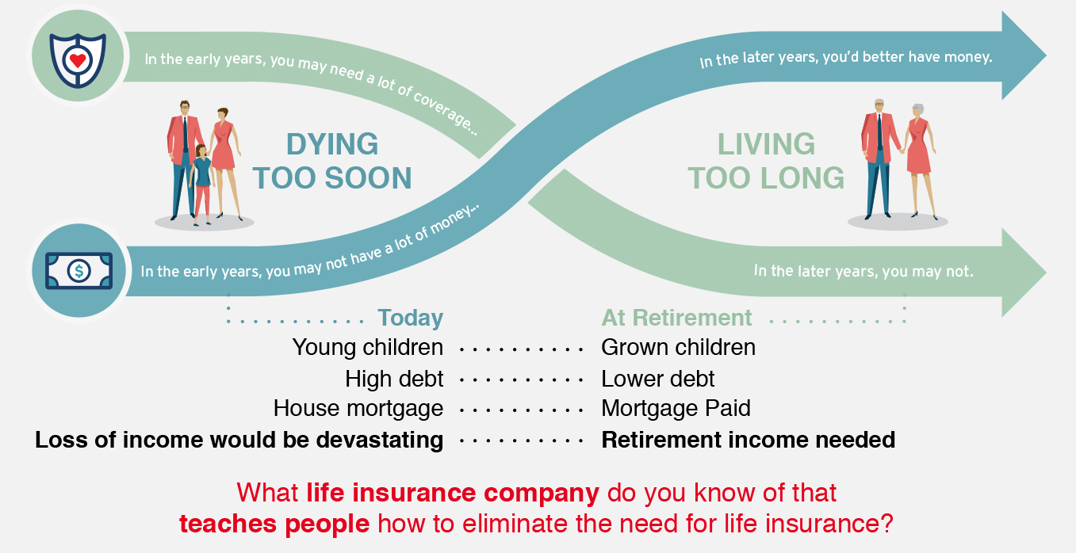
The Theory of Decreasing Responsibility

Slide 10
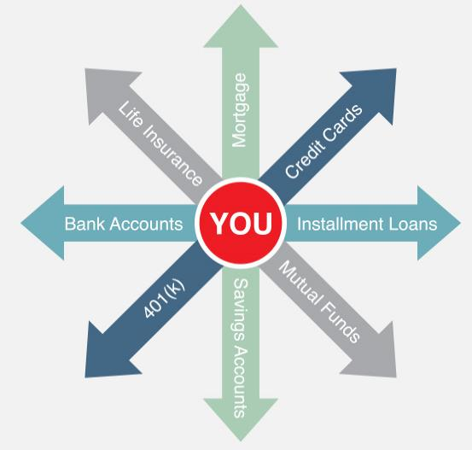
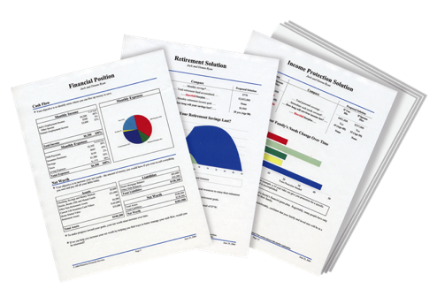
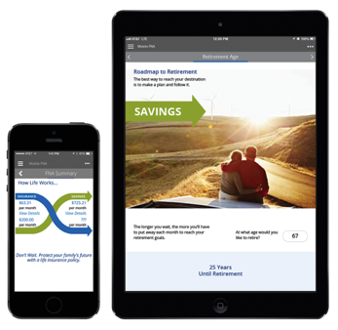
People Don’t Plan to Fail, They Fail to Plan
The Problem:
Traditional financial institutions sell you products. They don’t provide you with a total solution.
The Solution:
A Financial Needs Analysis. A customized, confidential and complimentary program that helps you achieve your goals and dreams.
A Financial GPS: It helps you find answers to important questions.

